Slide 1
DESIGN PROPOSAL FOR SOHO PROJECT REPORT Submitted by Divyansh Shukla(RA2111031010112) Yuvraj(RA2111031010097) Aditya Mishra(RA2111031010110) Deepanshu (RA2111031010066) Swarnim Gupta(RA2111031010101) 18CSC302J – Computer Networks SUBMITTED TO Submitted to Mrs. Geetha G Professor, Department of Networking and communication in partial fulfillment of the requirements for the degree of BACHELOROFTECHNOLOGY

Slide 2
ABSTRACT
The Small Office Home Office (SOHO) project aims to design and implement a network using Cisco Packet Tracer for a small office setup. The network is intended to support the networking needs of a small office or home office environment, with emphasis on scalability, security, and cost-effectiveness.
The network design includes the use of Cisco Packet Tracer, a powerful simulation tool that allows for the creation of virtual networks and the testing of network configurations in a safe and controlled environment. The network consists of multiple devices, including routers, switches, PCs, and servers, all configured using Cisco Packet Tracer.
The project focuses on meeting the networking requirements of a typical SOHO environment, including the establishment of local area network (LAN) connectivity, internet access, data segregation, security measures, and network management. VLANs are configured to separate different departments or users, and appropriate routing protocols and security features are implemented to ensure data integrity and confidentiality. The network is also designed to be scalable, allowing for future expansion or changes in the network requirements.
Security measures, such as firewalls, access controls, and intrusion detection and prevention systems, are implemented to protect the network from potential threats. Cost- effective solutions, such as choosing appropriate Cisco networking equipment and configurations, are considered to meet the budget constraints of a small office or home office setup.
The project is implemented and tested using Cisco Packet Tracer, with network configurations and simulations performed to validate the design and functionality of the SOHO network. The network is also managed and monitored using appropriate network management tools within Cisco Packet Tracer.

Slide 3
INTRODUCTION
BigBasket company is a fast-growing company in India with more than 2 million customers globally. The company deals with selling and buying of food items, which are basically operated from the headquarters. The company is intending to open a branch near the local village Potheri. Thus, the company requires young IT graduates to design the
network for the branch. The network is intended to operate separately from the HQ network.
Being a small network, the company has the following requirements during implementation;
One router and one switch to be used (all CISCO products).
3 departments (Admin/IT, Finance/HR and Customer service/Reception)
Each department is required to be in different VLANS.
Each department is required to have wireless network for the users.
Host devices in the network are required to obtain IPv4 address automatically.
Devices in all the departments are required to communicate with each other.
Assume the ISP gave out a base network of 192.168.1.0, you as the young network engineer who has been hired, design and implement a network considering the above requirements.

Slide 4
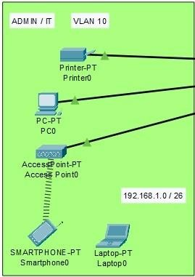
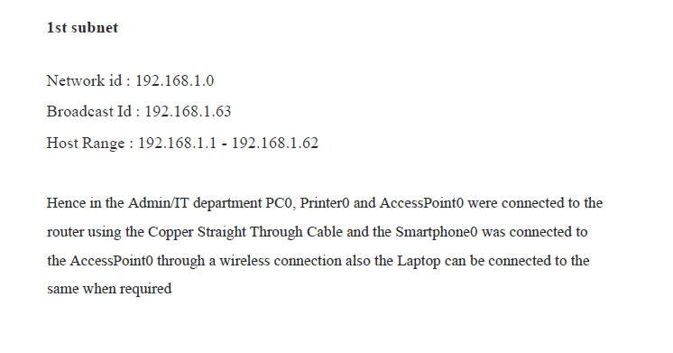
SYSTEM ANALYSIS
Setting up the network in the Admin / IT Department

Slide 5
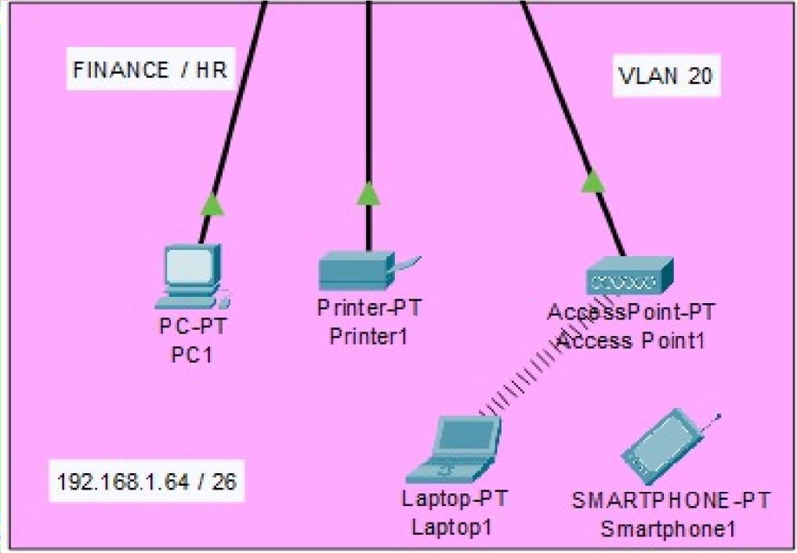
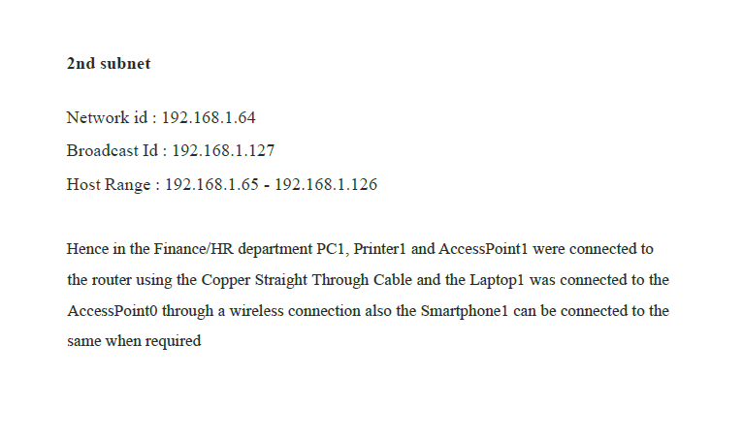
2) Setting up the network in the Finance / HR Department

Slide 6
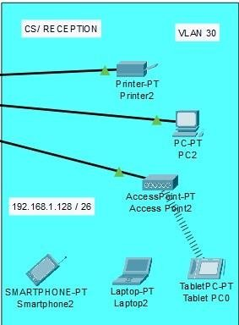
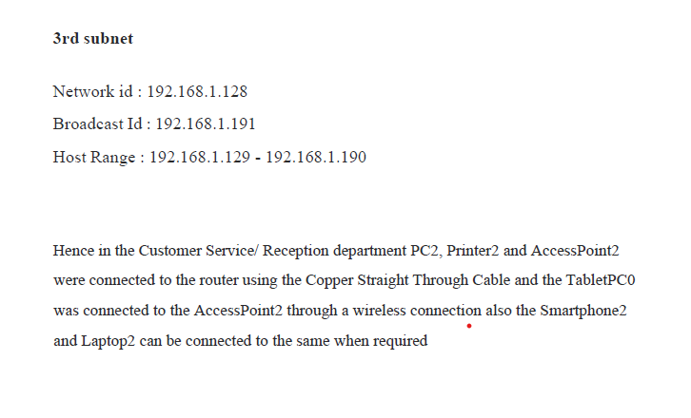
3) Setting up the network in the Customer Service Department

Slide 7
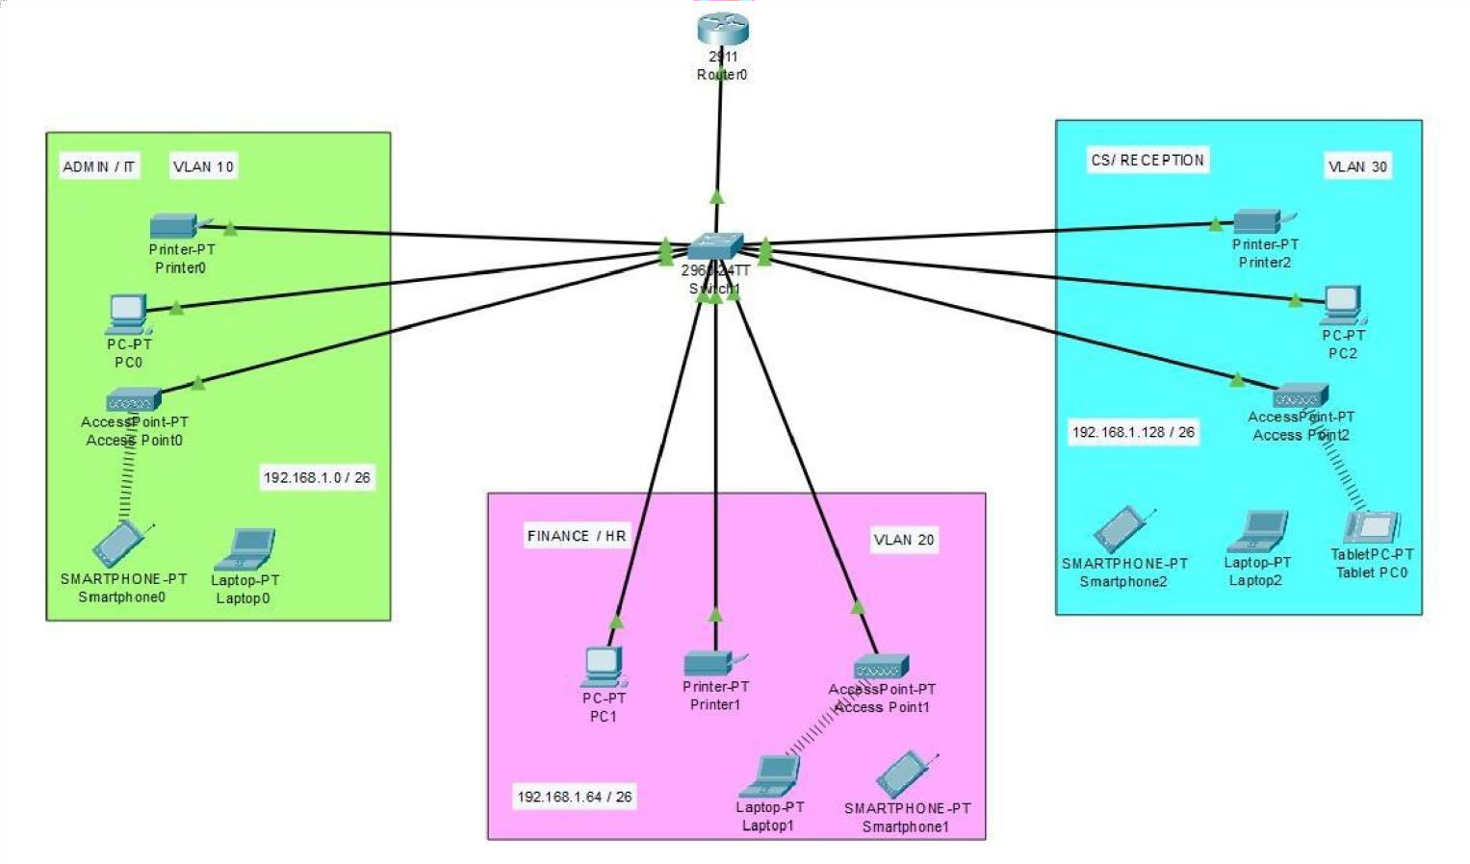
CONFIGURATION

Slide 8
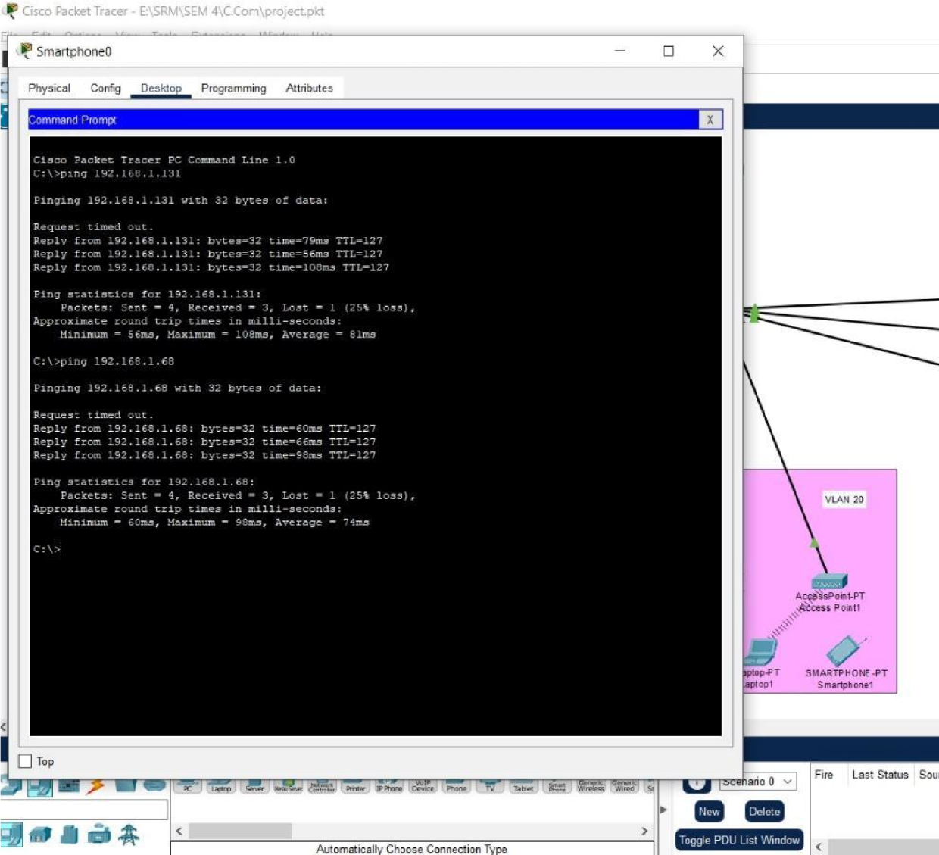
EXECUTION THROUGH CISCO PACKET TRACER

Slide 9
SERVICES AND FEATURES
The various services provided by the network are detailed as follows:
Instant network access – We are not adding a portal for login – we felt it was too cumbersome. Instead, we are adding twoWi-Fi routers – one is for the guests (open access, 1/3rd the normal speed), and one for the students, staff, etc. (password protected WPA2/PSK, normal speed).
Security – We have also enabled a selective example to showcase the security measures we could possibly undertake in the future – for example, we have enabled a 256- bit password in the console for the router.
There is also the provision for a Network Administrator added – the person(s) who can o Decrease, increase or otherwise modify the speeds of the network, o Shutdown or restart the entire network (only in cases of severe eventualities), o Add more sub-networks to the main networks (example – adding more users to a VLAN, incase a new department is established), o Sub-netting – although not done in our network due to complexity issues, it is possible for the network administrator(s) to establish sub-netting in case of lack of IP addresses

Slide 10
RESULT
In conclusion, the Small Office Home Office (SOHO) project using Cisco Packet Tracer has successfully achieved its objectives of designing and implementing a network for a small office or home office environment. The use of Cisco Packet Tracer as a simulation tool has provided a safe and controlled environment for network design, configuration, and testing.VLANs were configured to separate different departments or users, and appropriate routing protocols and security features were implemented to ensure data integrity and confidentiality. Cost-effective solutions were considered to meet the budget constraints of a small office or home office setup.

Slide 11
